Slide 1
CT216 Quantization
A Few More Points and a Recap
18th March 2024

Slide 2
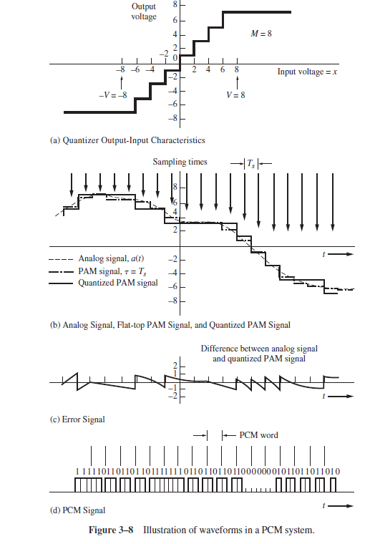

Slide 3
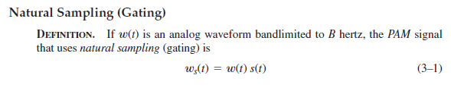
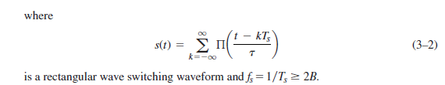

Slide 4
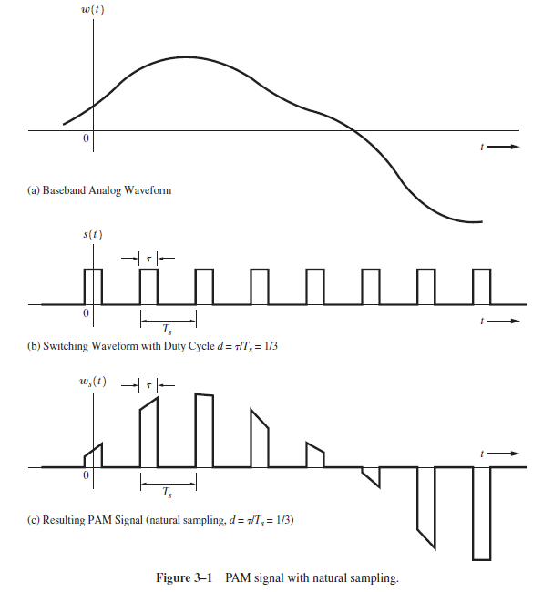
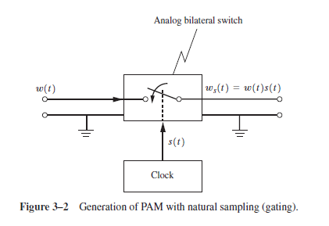

Slide 5

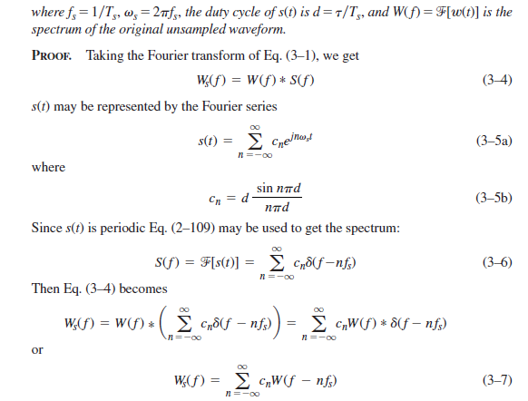

Slide 6
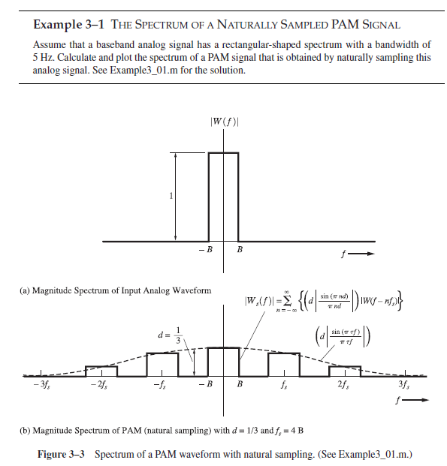

Slide 7
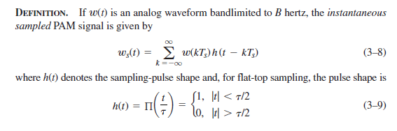


Slide 8
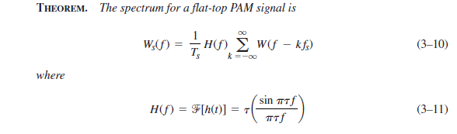
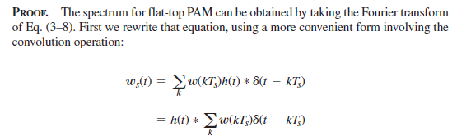

Slide 9
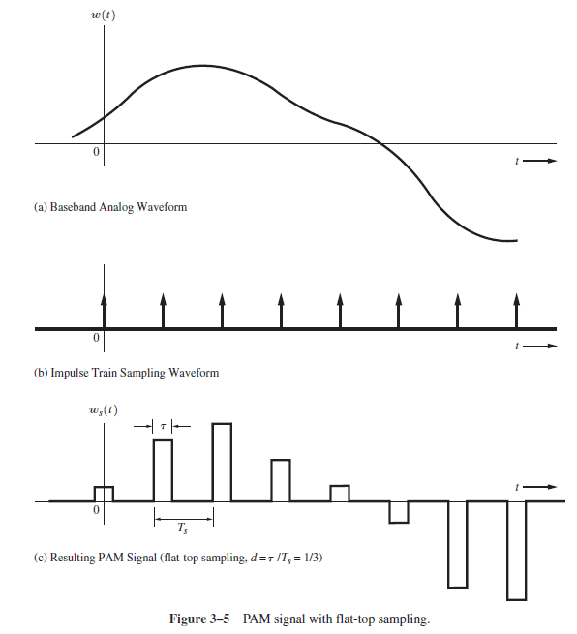
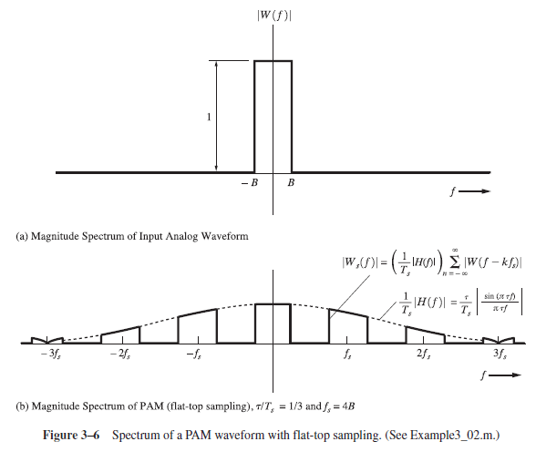

Slide 10
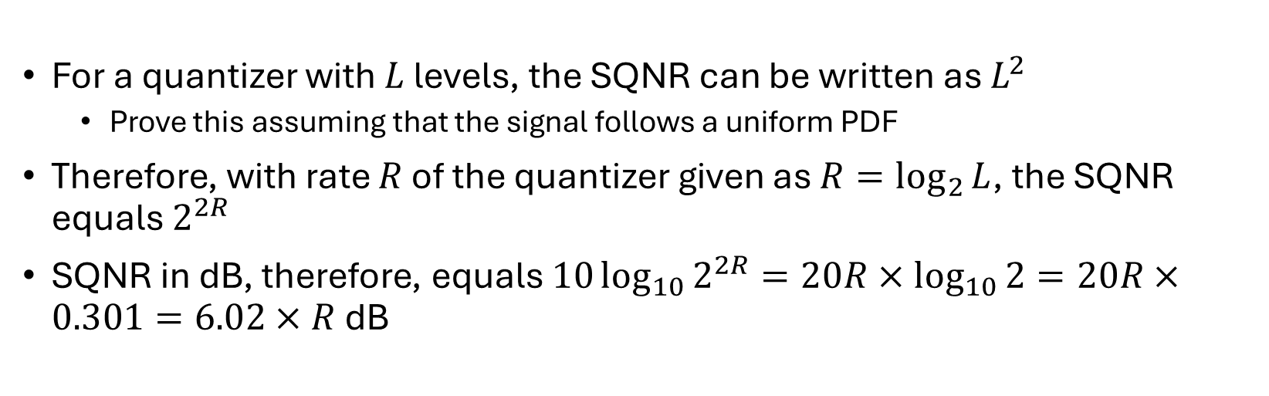
Average Signal to Quantization Noise Ratio (SQNR)
For a quantizer with $L$ levels, the SQNR can be written as $L^{2}$
Prove this assuming that the signal follows a uniform PDF
Therefore, with rate $R$ of the quantizer given as $R=\log_{2}{L}$, the SQNR equals $2^{2R}$
SQNR in dB, therefore, equals $10\log_{10}{2^{2R}}=20R×\log_{10}{2}=20R×0.301=6.02×R$ dB

Slide 11
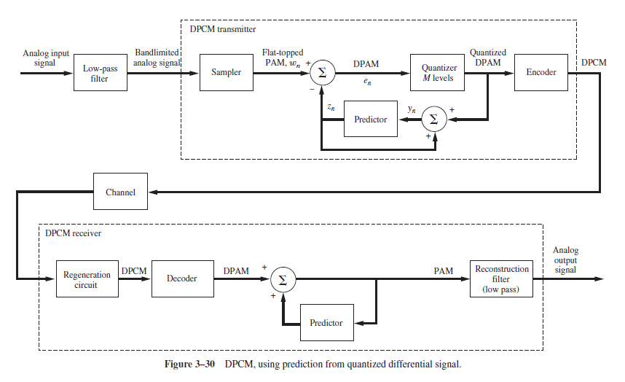

Slide 12
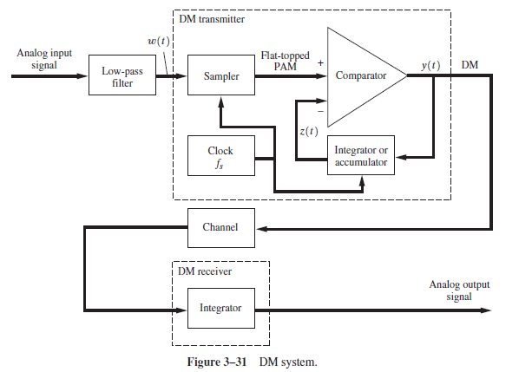

Slide 13
